Slide 1
File and Record Organization

Slide 2
File Organization
File → organized as sequence of records.
Record → sequence of fields.
Each ﬁle is also logically partitioned into ﬁxed-length storage units called blocks.
A block may contain/n several records.
Size of a block vary from 4KB to 8KB.

Slide 3
Files
A database consist of a huge amount of data. The data is grouped within a table in RDBMS, and each table have related records.
A user can see that the data is stored in form of tables, but in actual this huge amount of data is stored in physical memory in form of files.
File – A file is named collection of related information that is recorded on secondary storage such as magnetic disks, magnetic tables and optical disks.

Slide 4
What is File Organization?
File Organization refers to the logical relationships among various records that constitute the file, particularly with respect to the means of identification and access to any specific record.
In simple terms, Storing the files in certain order is called file Organization.
File Structure refers to the format of the label and data blocks and of any logical control record.

Slide 5
Types of File Organizations
Sequential File Organization
Heap File Organization
Hash File Organization
B+ Tree File Organization
Clustered File Organization

Slide 6
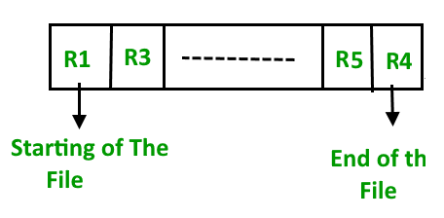
Sequential File Organization
The easiest method for file Organization is Sequential method. In this method the file are stored one after another in a sequential manner. There are two ways to implement this method:
Pipe File Method – This method is quite simple, in which we store the records in a sequence i.e one after other in the order in which they are inserted into the tables.

Slide 7
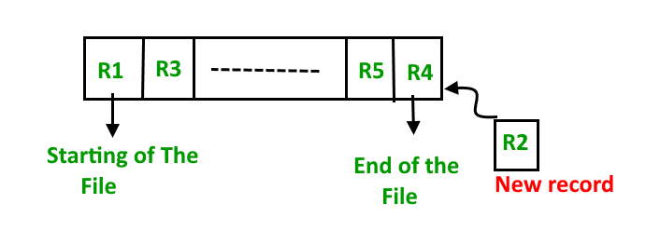
Insertion of new record – Let the R1, R3 and so on upto R5 and R4 be four records in the sequence. Here, records are nothing but a row in any table.
Suppose a new record R2 has to be inserted in the sequence, then it is simply placed at the end of the file.

Slide 8
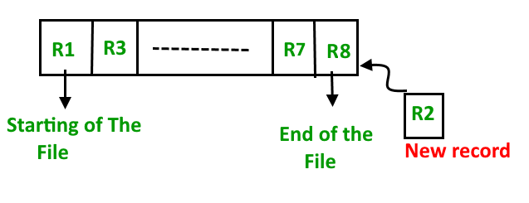
2. Sorted File Method
In this method, As the name itself suggest whenever a new record has to be inserted, it is always inserted in a sorted (ascending or descending) manner.
Sorting of records may be based on any primary key or any other key.

Slide 9
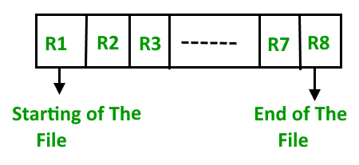
Insertion of new record – Let us assume that there is a preexisting sorted sequence of four records R1, R3, and so on upto R7 and R8.
Suppose a new record R2 has to be inserted in the sequence, then it will be inserted at the end of the file and then it will sort the sequence .

Slide 10
Pros and Cons of Sequential File Organization – Pros –
Fast and efficient method for huge amount of data.
Simple design.
Files can be easily stored in magnetic tapes i.e cheaper storage mechanism.
Cons –
Time wastage as we cannot jump on a particular record that is required, but we have to move in a sequential manner which takes our time.
Sorted file method is inefficient as it takes time and space for sorting records.

Slide 11
Heap File Organization
Heap File Organization works with data blocks. In this method records are inserted at the end of the file, into the data blocks.
No Sorting or Ordering is required in this method.
If a data block is full, the new record is stored in some other block, Here the other data block need not be the very next data block, but it can be any block in the memory.
It is the responsibility of DBMS to store and manage the new records.

Slide 12
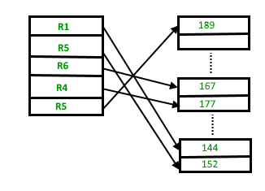
Heap File Organization

Slide 13
Insertion of new record –
Suppose we have four records in the heap R1, R5, R6, R4 and R3 and suppose a new record R2 has to be inserted in the heap then,
since the last data block i.e data block 3 is full it will be inserted in any of the data blocks selected by the DBMS, lets say data block 1.
If we want to search, delete or update data in heap file Organization the we will traverse the data from the beginning of the file till we get the requested record.
Thus if the database is very huge, searching, deleting or updating the record will take a lot of time.

Slide 14
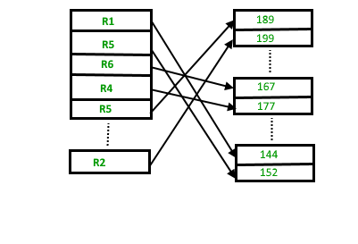
Insertion of new record

Slide 15
Pros and Cons of Heap File Organization – Pros –
Fetching and retrieving records is faster than sequential record but only in case of small databases.
When there is a huge number of data needs to be loaded into the database at a time, then this method of file Organization is best suited.
Cons –
Problem of unused memory blocks.
Inefficient for larger databases.

Slide 16
Hash File Organization
Hash File Organization uses the computation of hash function on some fields of the records. The hash function's output determines the location of disk block where the records are to be placed.
Hash File Organization :
Data bucket – Data buckets are the memory locations where the records are stored. These buckets are also considered as Unit Of Storage.
Hash Function – Hash function is a mapping function that maps all the set of search keys to actual record address.
Generally, hash function uses primary key to generate the hash index – address of the data block. Hash function can be simple mathematical function to any complex mathematical function.

Slide 17
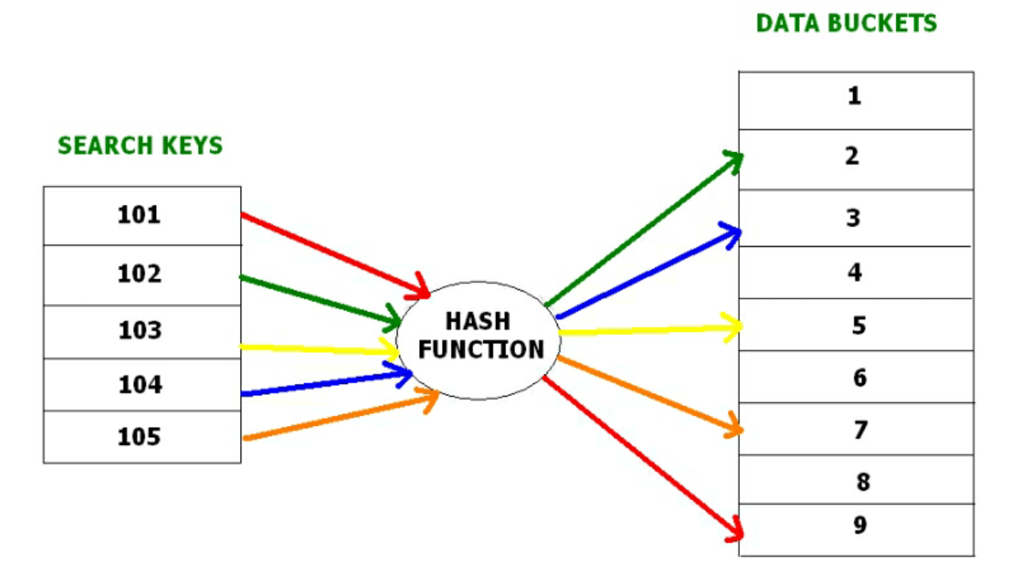
Hash File Organization

Slide 18
B+ File Organization
B+ tree file organization is the advanced method of an indexed sequential access method. It uses a tree-like structure to store records in File.
It uses the same concept of key-index where the primary key is used to sort the records. For each primary key, the value of the index is generated and mapped with the record.
The B+ tree is similar to a binary search tree (BST), but it can have more than two children. In this method, all the records are stored only at the leaf node. Intermediate nodes act as a pointer to the leaf nodes. They do not contain any records.

Slide 19
Pros of B+ tree file organization
In this method, searching becomes very easy as all the records are stored only in the leaf nodes and sorted the sequential linked list.
Traversing through the tree structure is easier and faster.
The size of the B+ tree has no restrictions, so the number of records can increase or decrease and the B+ tree structure can also grow or shrink.
It is a balanced tree structure, and any insert/update/delete does not affect the performance of tree.
Cons of B+ tree file organization
This method is inefficient for the static method.

